Slide 1
DATA CENTER FOR KOREA REUNIFICATION
#REUNIFICATION OF KOREA
21000127 Aaron Kim
21100713 ByungMin Choe
21500001 Gabriel
21500514 Areum Lee

Slide 2
REUNIFICATION OF KOREA
INDEX
Introduction about our system.
Demo
Changes
Our best scenarios
Challenges
Notes:
Hello, My name is Byung Min Choi of 디비라 Team. Today I present the DATA CENTER FOR KOREA REUNIFICATION. I will explain our team’s subject in following order.

Slide 3
REUNIFICATION OF KOREA
Data center for Korea reunification
: Creating a System
to Collect and Search data
of various fields related to North Korea
Notes:
We made the system to search and store data related to North Korea

Slide 4
REUNIFICATION OF KOREA
Advantage of our Database
Provide Data related to unification to support user who is interested.
Usefulness of integrated database related to unification.
Provide a useful database for North Korean defector.
Users can share their ideas in posts.
Notes:
In Our database,we plan to Provide Data related to unification to support user who is interested and Provide a useful database for North Korean defector.
Also, Users can share their ideas in posts.

Slide 5
REUNIFICATION OF KOREA
DEMO
link:
https://youtu.be/nFc7SCLH5eU

Slide 6
REUNIFICATION OF KOREA
Previous Schemas
Government(Department, key_person, name, position)
BrokerPricelist(matter_id, year, price)
Videolist(Video_id, Video_name)
Underground Resources(U_region, resource_type, quantity)
Languages(Word_id, North_word, South_word)
Environment(N/S, temperature, E_region, Precipitation, E_year, wind_speed)
Populations(N/S, D_population, P_year, density, population, male, female, sex_ratio)
Korea (N/S)
Userlist(user_id, password)
Postlist(user_id, post_id, text, date)
Searchlist(user_id, words, date)
articlelist(article_id,link,date)
Notes:
Government는 우리가 북한 관련 기사를 접하거나 북한의 조직체계를 알고 싶을 때 주요 인물들에 관한 정보가 없으면 이해하기 어렵기 때문에 그 이해를 돕고자 북한의 주요인물들의 이름, 직급 등의 정보를 담고 있다.
BrokerPriceList는 탈북민들에게는 중요한 정보로 탈북을 하기 위해 필요한 돈의 시세가 어느 정도인지에 대한 정보를 담고 있다. 탈북민 중에 가족이 아직 북한에 있는 사람들이 관심을 가지고 있을 것이다.
VidoList를 통해서는 북한의 문화생활을 엿볼 수 있다. 북한에서 상영하는 영화, 드라마나 북한, 탈북, 통일에 관련된 영화, 다큐 등의 비디오들을 보여준다.
Underground Resources 통일의 효과로 기대하는 부분이 북한의 풍부한 자원을 활용하는 것이다. 북한에 자원이 어느정도 있는지 보여준다.

Slide 7
Present Schemas
bulletin (num, title, author, date, contents)
bulletin_trash (num, title, author, date, contents)
comment (commentn, comment, author, date, title)
dictionary (id, north, south)
environment (distribution, year, temperature, precipitation, wind_speed, ns)
news (idnews, title, link, date, count)
population_north (year, population, population_density, male, female, sexratio, birth_since_nationaldivision)
population_ns (year, population, population_density, male, female, sexratio, birth_since_nationaldivision)
population_south (year, population, population_density, male, female, sexratio, birth_since_nationaldivision)
price (idprice, price, year)

Slide 8
resources (year, coal, iron_ore, crude_steel, ns)
scenarios (scnearion, title, contents)
searchword (userid, word, time)
tablecount (number, title, tableName, count)
user (iduser, name, id, password, class)
video (idvideo, videoname, link, count, date)
city (name)
time_view(title, date)
recent_view(userid, word, time)
count_view(title, count)
maxmin_view(year, price)
avg_view(year, AVG(price))

Slide 9
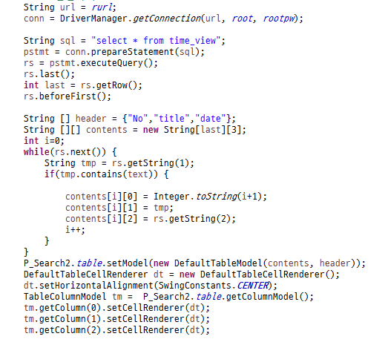
REUNIFICATION OF KOREA
Best Scenarios
1. Search function
→ Search by article title only on video or news
→ Search by article title or contents on statistics
→ If it is a statistics ,not an article, just show all the tables related to keyword

Slide 10
2. Triggers
① `bulletin_AFTER_DELETE_1`
→ When deleting an article on the bulletin, insert the article into another table named ‘bulletin_trash’
sql : CREATE DEFINER=`root`@`localhost` TRIGGER
`bulletin_AFTER_DELETE_1` AFTER DELETE ON `bulletin` FOR
EACH ROW BEGIN
insert into bulletin_trash values(old.num,old.title,old.author,old.date,old.contents);
END
② `bulletin_AFTER_DELETE`
→ When deleting an article on the bulletin, delete the comments of the article
sql : CREATE DEFINER=`root`@`localhost` TRIGGER
`bulletin_AFTER_DELETE` BEFORE DELETE ON `bulletin` FOR
EACH ROW BEGIN
DELETE FROM comment WHERE comment.title=old.title;
END

Slide 11
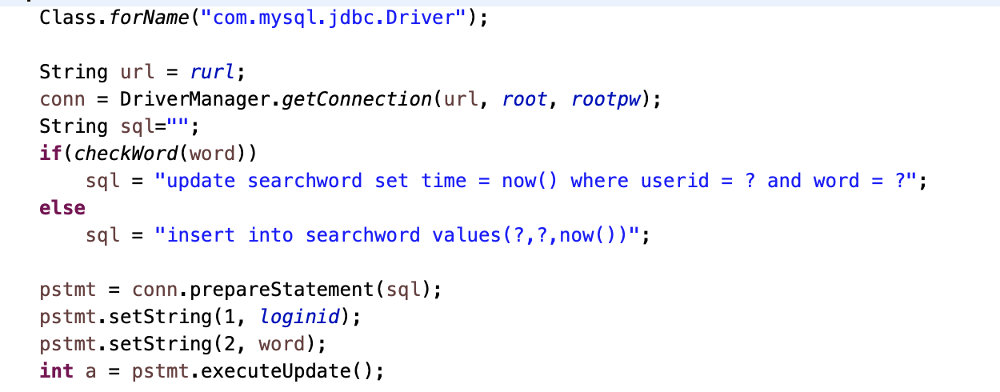
REUNIFICATION OF KOREA
3. Recent Search List
→ Select datas to check repetition of id,word in ‘searchword’ table
→ When inserting a word into ‘searchword’ table
→ When the word exist already, update the time of the data
→ When the word is new, just insert.
→ Five recent search terms of a user

Slide 12
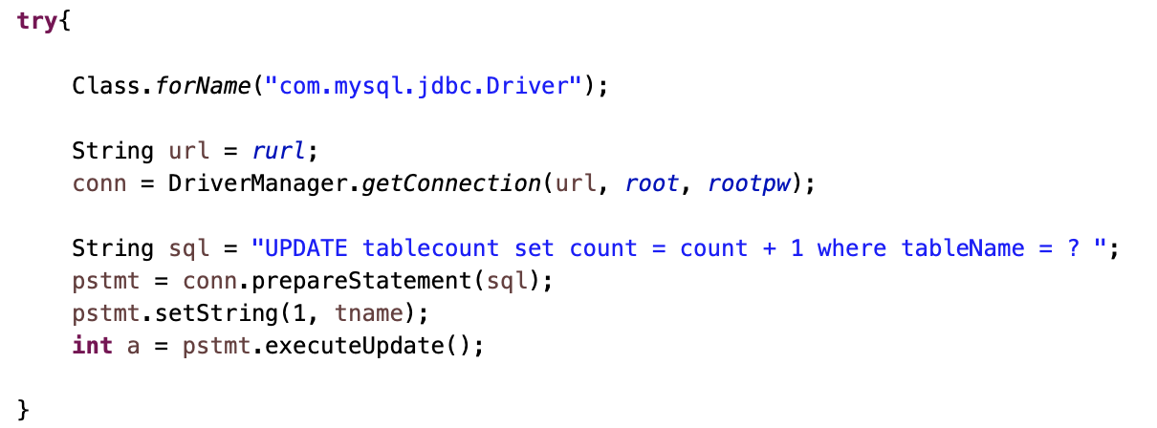
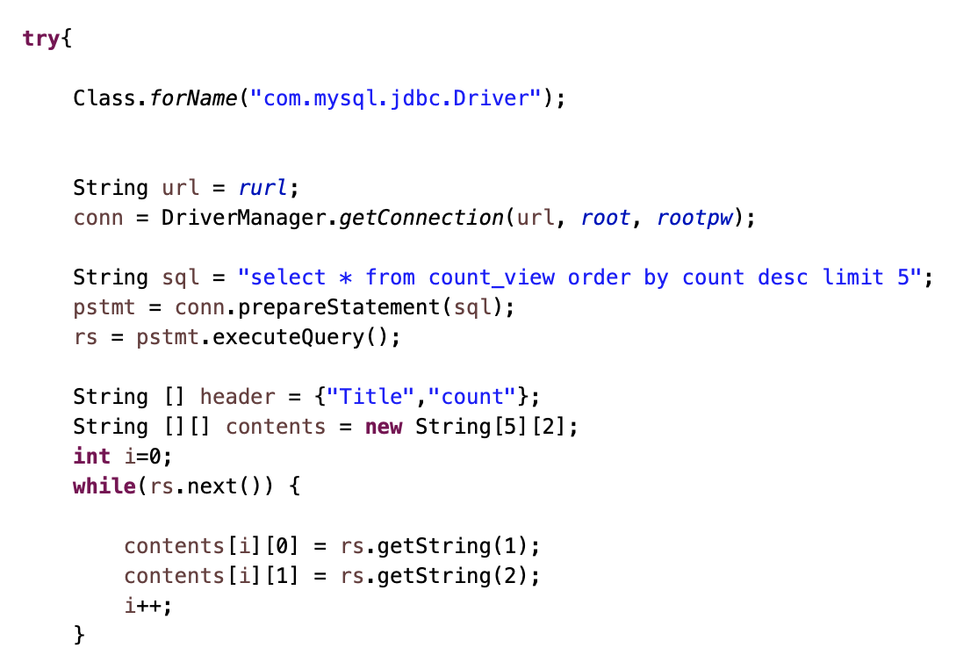
REUNIFICATION OF KOREA
4. Top 5 view
→ Increase a count of the views of statistics
→ Top five of the most number of views in all news,video and statistics
Notes:
select * from count_view

Slide 13
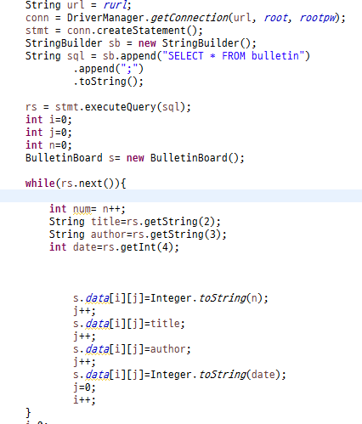
REUNIFICATION OF KOREA
5. Communication board
→ select bulletin table and show it on GUI jtable
→ Write post on bulletin board
→ delete post from bulletin table
→ select bulletin table of selected title and show its title, author and contents
→ select comment table by selected bulletin post title
→ Add comment

Slide 14
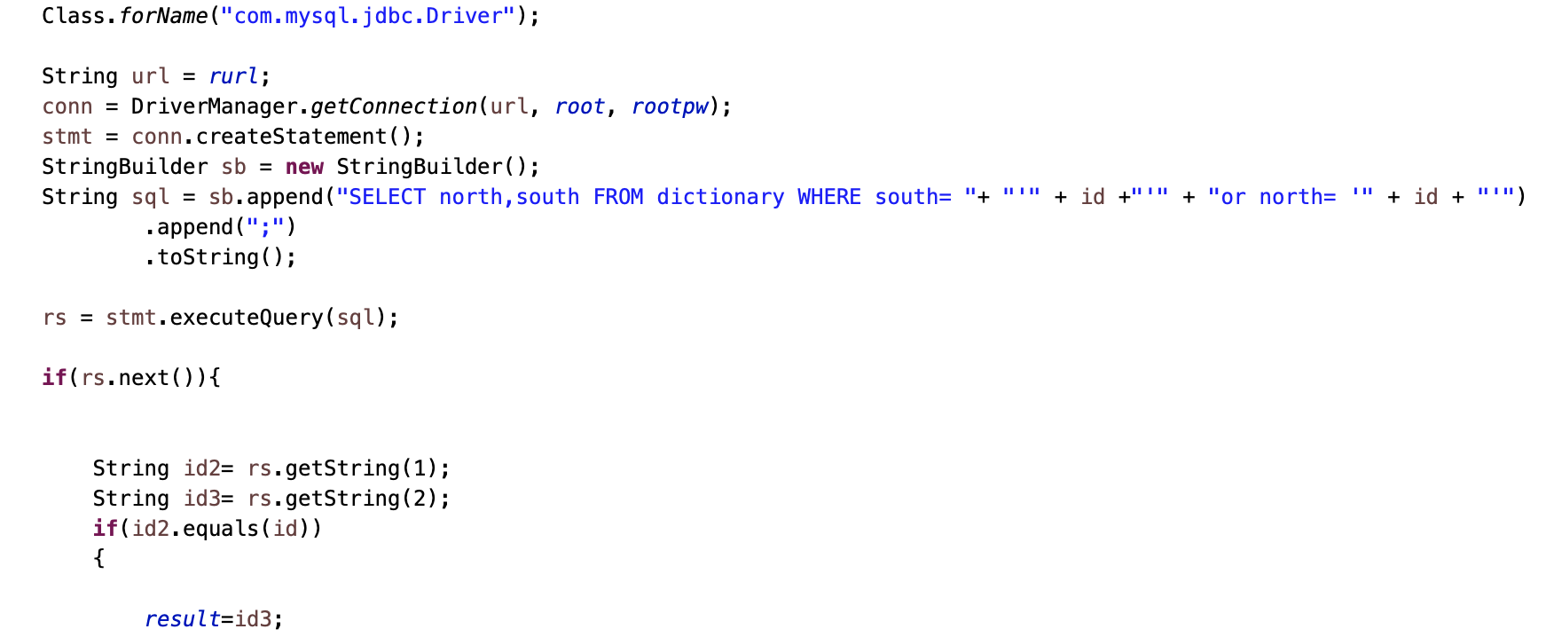
REUNIFICATION OF KOREA
6. Quiz
→ show north, south Korean word on quizlist
→ check north Korean word meaning in south korea by select dictionary table

Slide 15
REUNIFICATION OF KOREA
Challenges
When making GUI for the program, it was a little difficult to make buttons in the JTable work when clicked
When writing query, we had a difficulty checking all the data in search function
When creating a table, we considered whether to create a separate table for the North / South division or not.
→ So we distinguished between North and South by attributes such as environment or resource and did not distinguish attribute such as n/s.

Slide 16
Q&A
#REUNIFICATION OF KOREA
Thank you :)

